Slide 1

Game Development 101
By: Andrew Bernhardt

Slide 2
About Me
Senior at UofSC (Honors College)
Computer Science Major (B.S)
2 Internships in Software Development

Slide 3


Summer 2022
Summer 2021

Slide 4
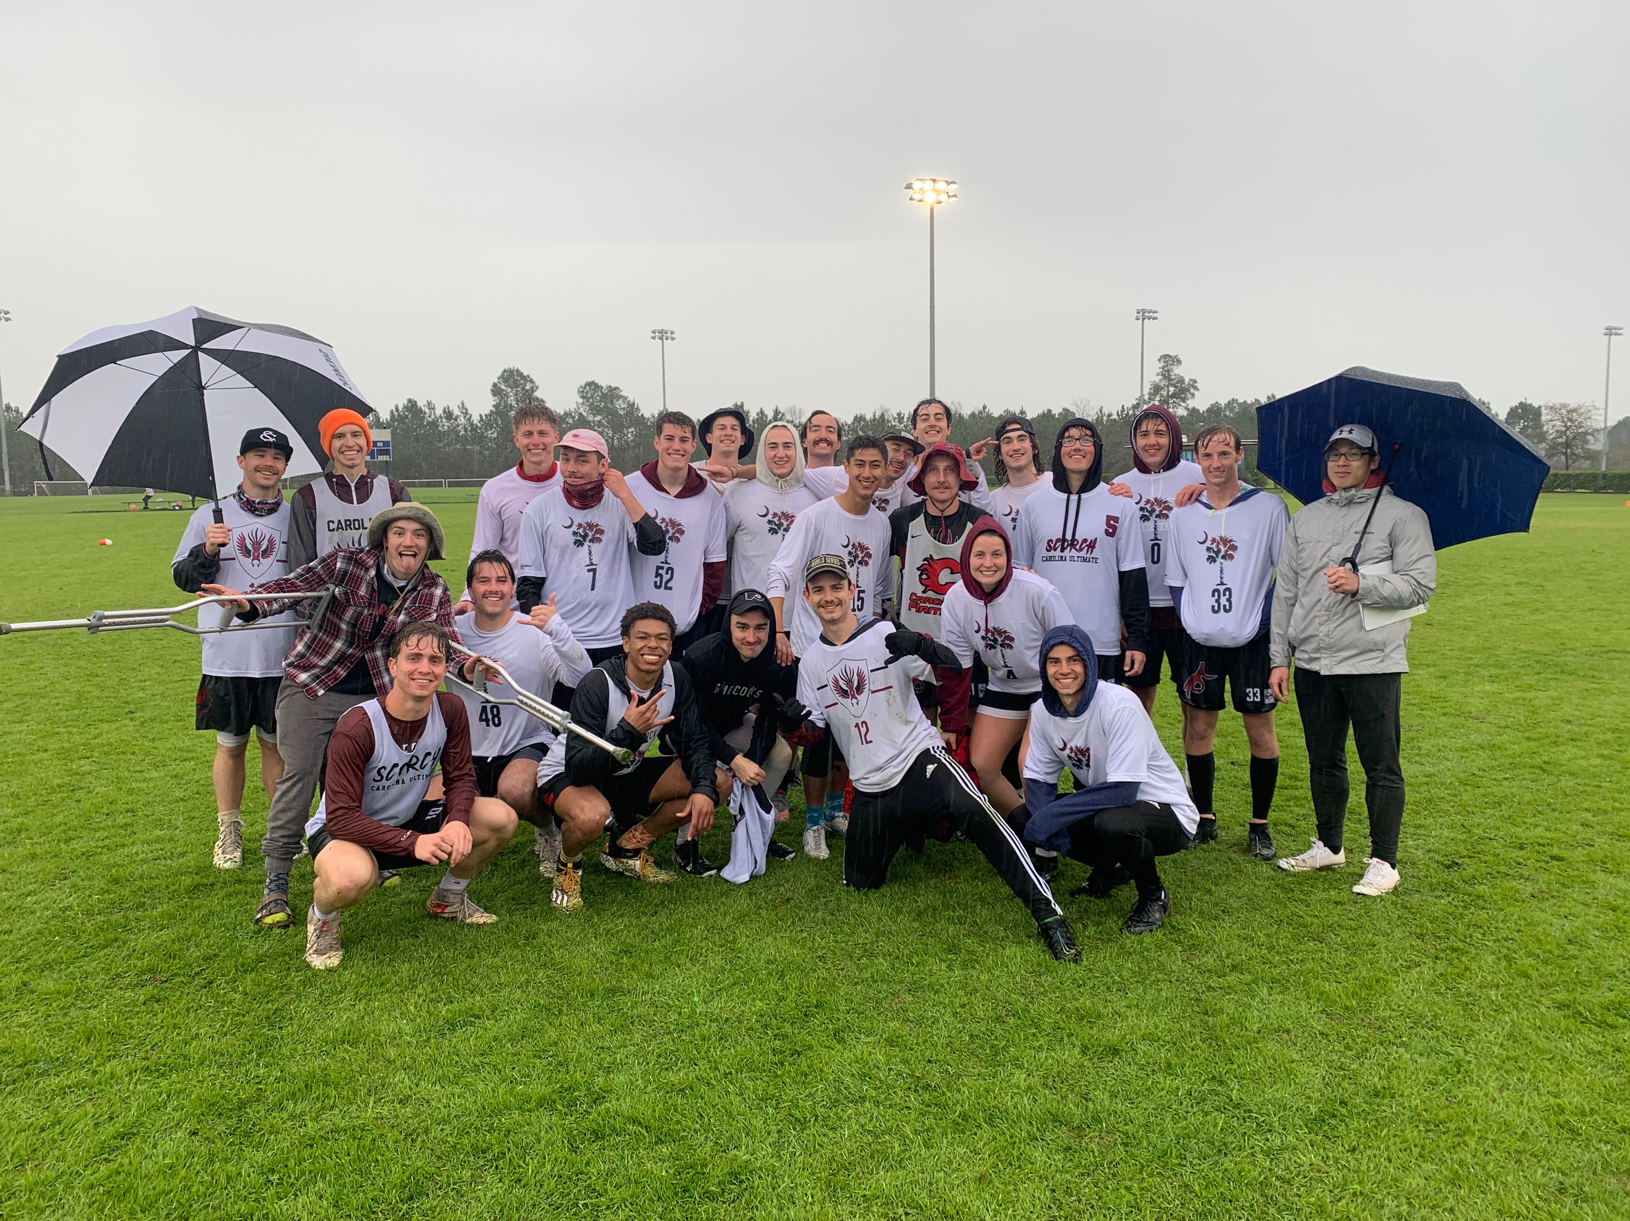
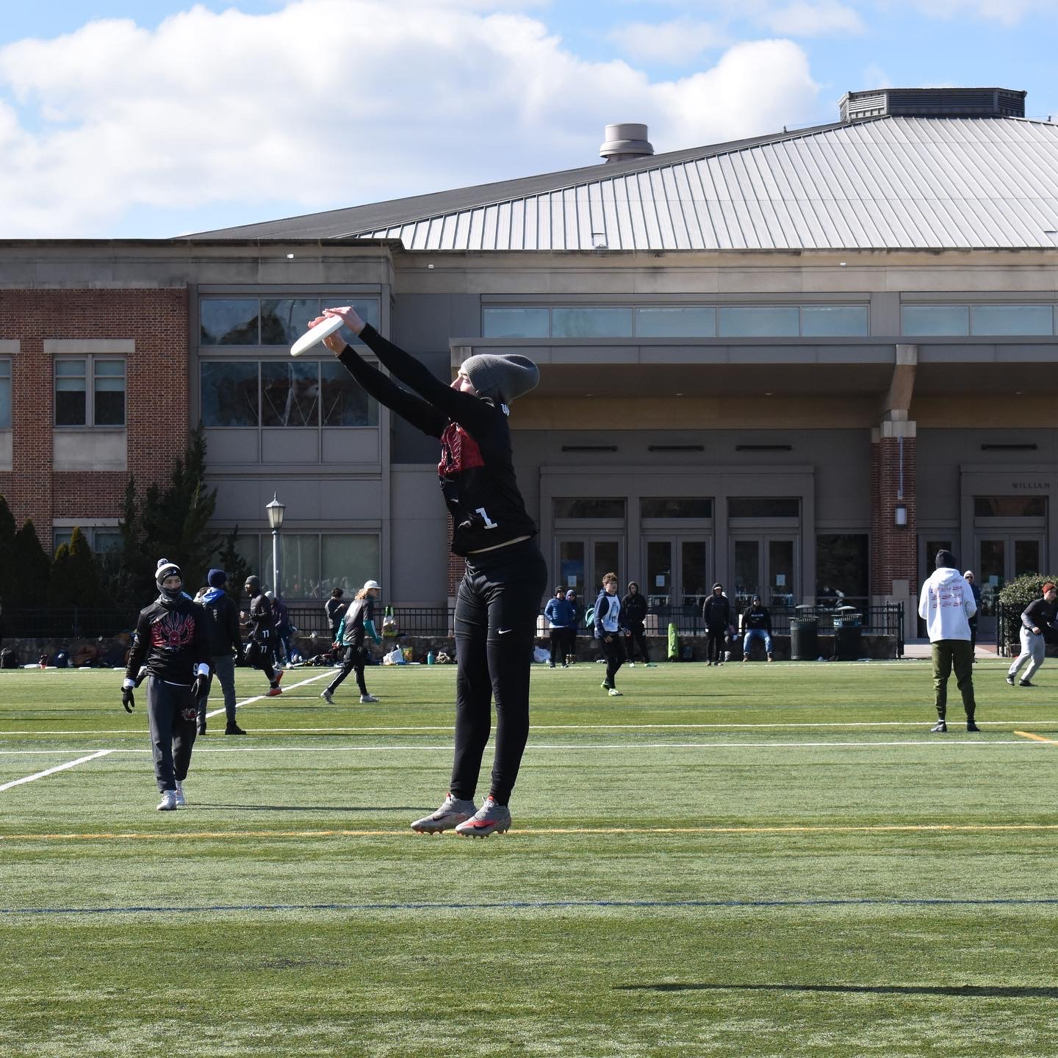
About Me (Fun Stuff!)
Club Ultimate Frisbee

Slide 5
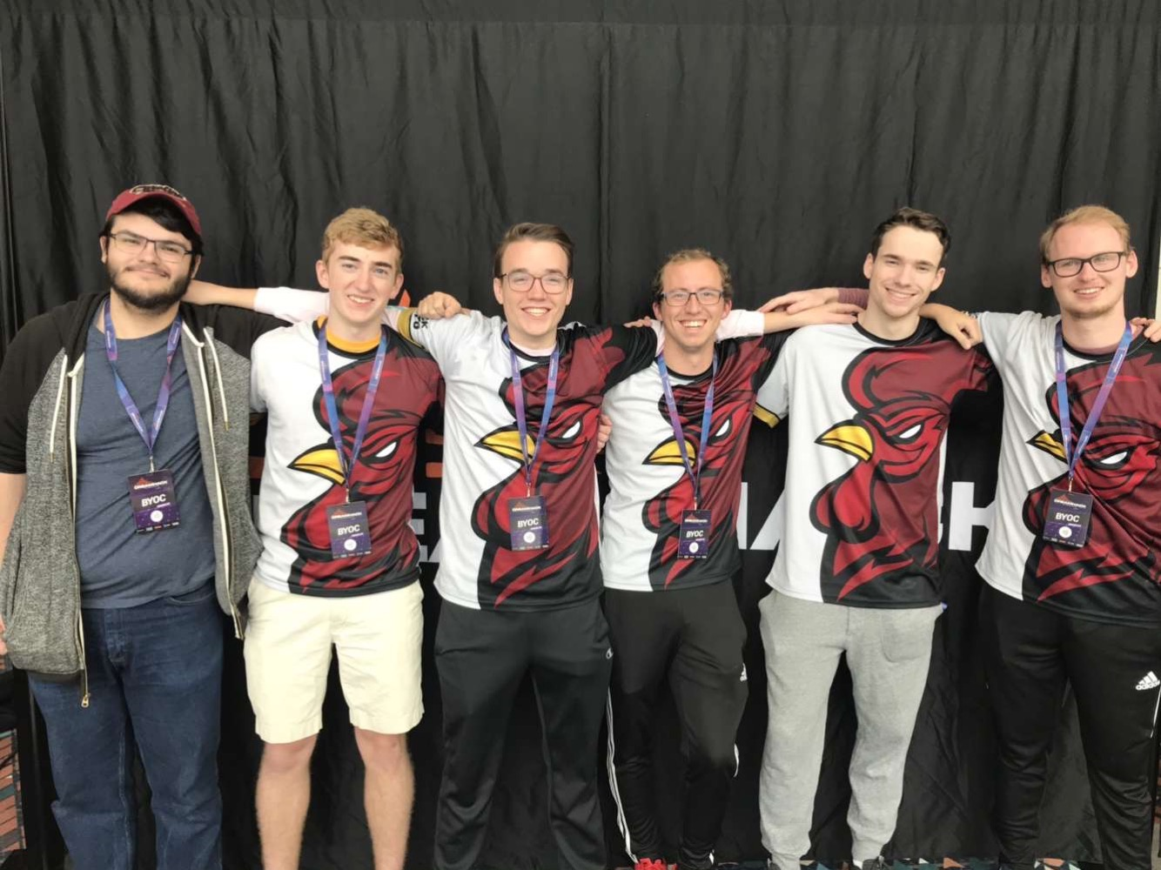



Slide 6


Slide 7
Ask me about…
Club Sports
Esports
Clubs
Driving in Columbia
Computer Science
Housing
Classes
Honors College
Theology/Church
Tutoring on Campus
Fun things to do in Columbia
Hiking/Camping
Working out
Mac vs Windows
Man Buns
Career paths
OR ANYTHING ELSE…

Slide 8
Game Development 101
By: Andrew Bernhardt

Slide 9


Slide 10
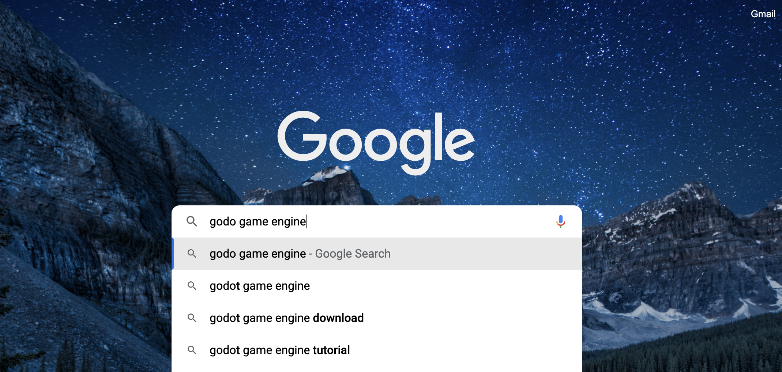
DOWNLOAD IT!!

Slide 11
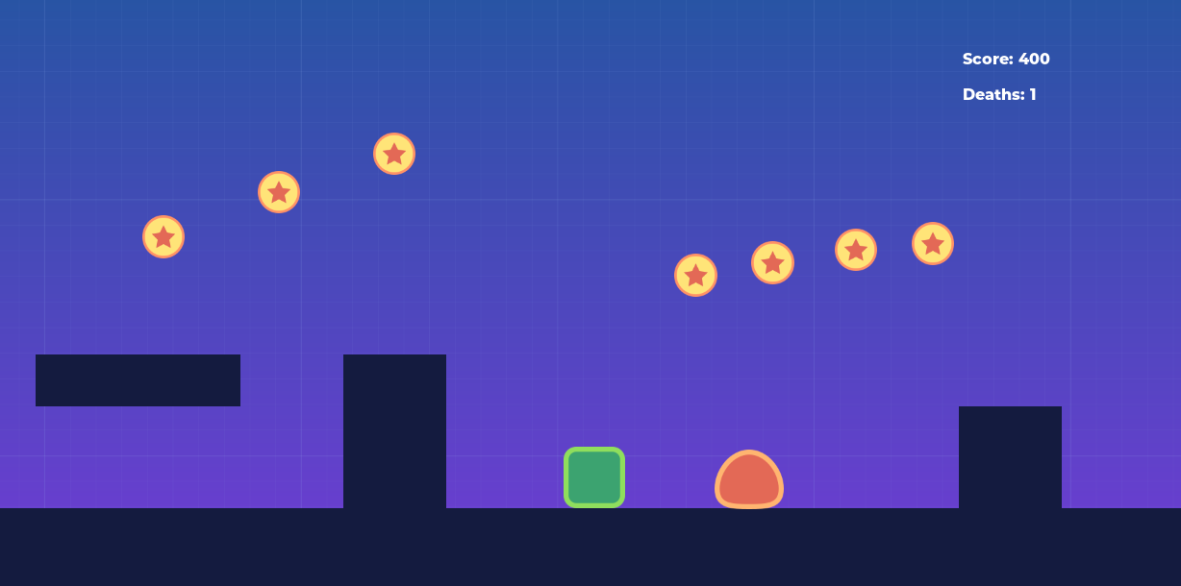

Slide 12
Optional Customization
Text Choices
Background Pictures
Character “Sprites”
Map Design

Slide 13
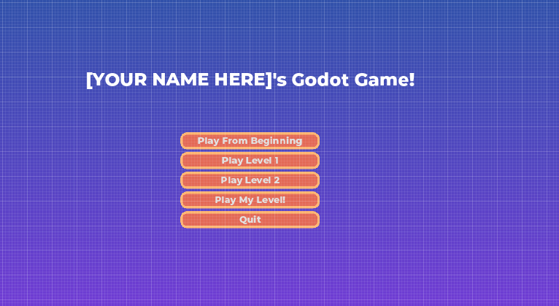
Customizable Game Pieces
Notes:
I want all of you to go home and have a custom game

Slide 14
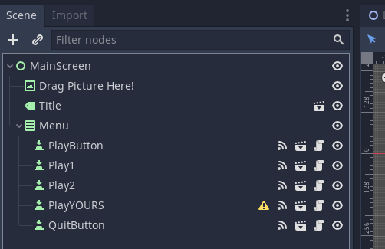
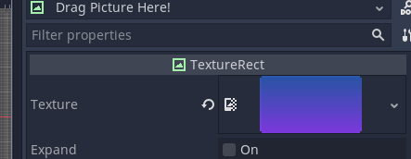
Background!
Add a home screen background

Slide 15
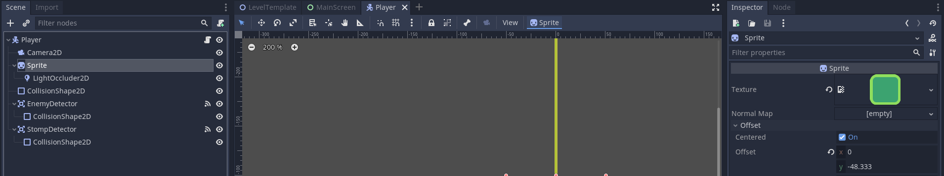
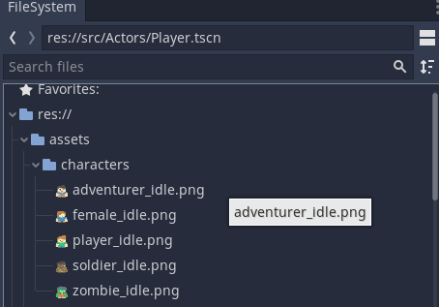
Character “Sprites”

Slide 16
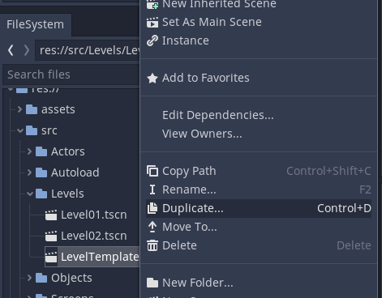
Map Design
Duplicate your level template before you make it!
This way you still have your template…

Slide 17
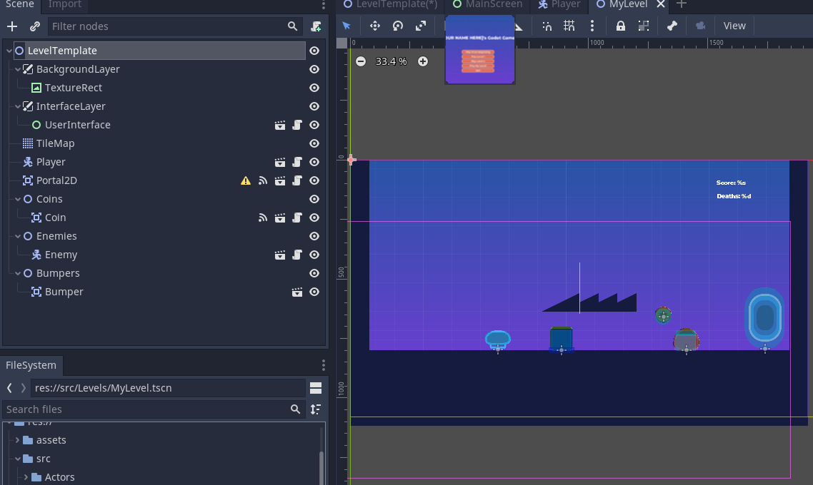
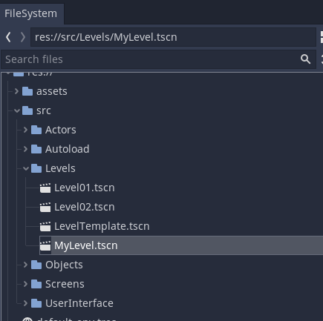
Map Design
First, Click on “MyLevel.tscn” in File System
Or whatever you named it!

Slide 18
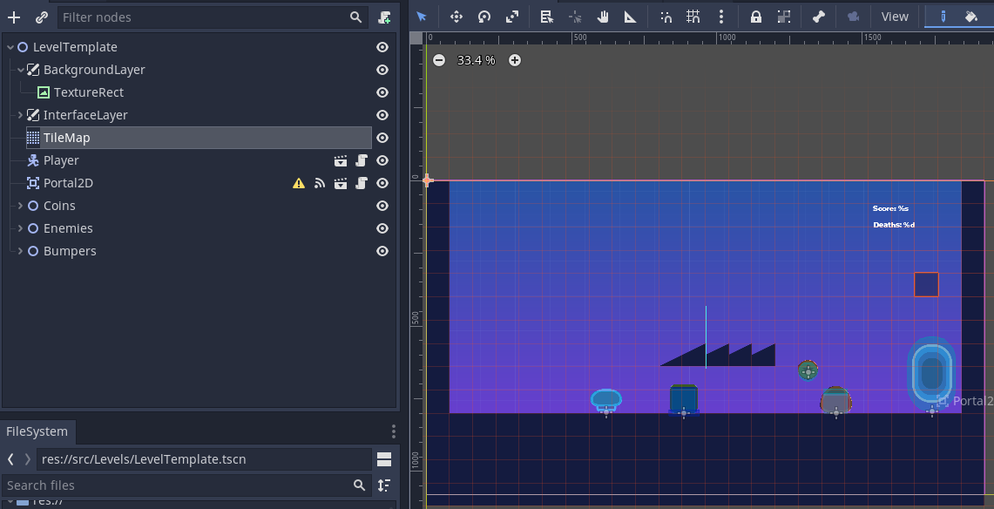
Map Design
Click on TileMap to add/remove blocks with left/right click
Click on the Player/Coin/Enemy/Bumpers to use them
Duplicate them to add more!

Slide 19
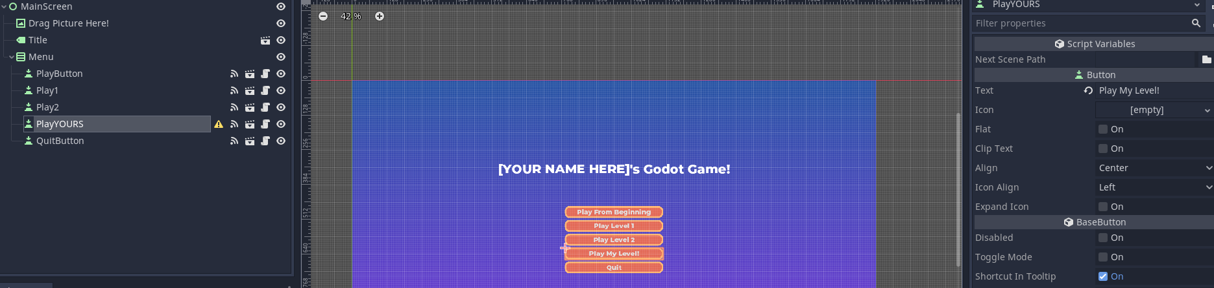
Connect Map to the Game!
Add your new level in “Next Scene Path”

Slide 20
Want to do more?
YouTube is how we learn!
Here is a link to videos that help explain the game
This work is not by my own design! I follow tutorial (even as a senior!) and help teach those to others!

